Slide 1


Towards a Model for Predicting Overland Trafficking Routes Cornell, Harry Necaise, Aaron Robkin, Jessica IDS 6916 Research Practicum Final Presentation

Slide 2
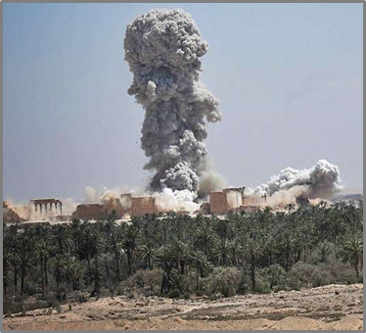
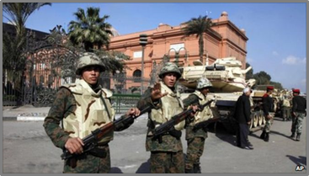
Introduction - Terrorism and the Theft of Cultural Heritage
Regional background
Arab Spring & Syrian Civil War in 2011 leads to destruction of cultural heritage sites and museums across the region.
In the intervening years, widespread archaeological site looting by both terrorist and government actors occurs.
Destruction of Palmyra, 2016. Photo: Arbresh.info
Cairo Museum, 2011. Photo: AP/BBC News
Notes:
Since the beginning of the Syrian Civil war in 2011, extremist groups have taken advantage of the chaos and instability to loot and destroy archaeological sites and museums throughout Syria and into parts of Iraq, the most notable widely covered of which have been the 2014-2015 capture of Mosul and subsequent destruction of the Mosul Museum and Library.
In 2015, ISIS took bulldozers and explosives to Nimrud, vandalizing Hatra, Nineveh, Khorsabad, and others. The destruction of Palmyra in 2016 was another devastating blow to world cultural heritage.
While the primary players in this story that we are all familiar with are Al-Qaeda and ISIS, we must not forget the importance of local gangs of organized looters, as well as subsistence looters, that take advantage of inadequately protected cultural property to loot for a variety of reasons.
So, why is this happening?
The reasons why the destruction and looting of cultural property is happening both in the Middle East and across the globe seem to fall into a number of categories.
Failure to protect archaeological sites and cultural property, poverty, religious ideology, propaganda, and last, but most certainly not least, supply and demand, are some of the contributing factors of this issue
Extremist Muslim groups have used religious ideology as a driving motivation for destruction of idolatrous heritage. The Taliban made no qualms about destroying the Bamiyan Buddhas in Afghanistan for just this very reason.

Slide 3
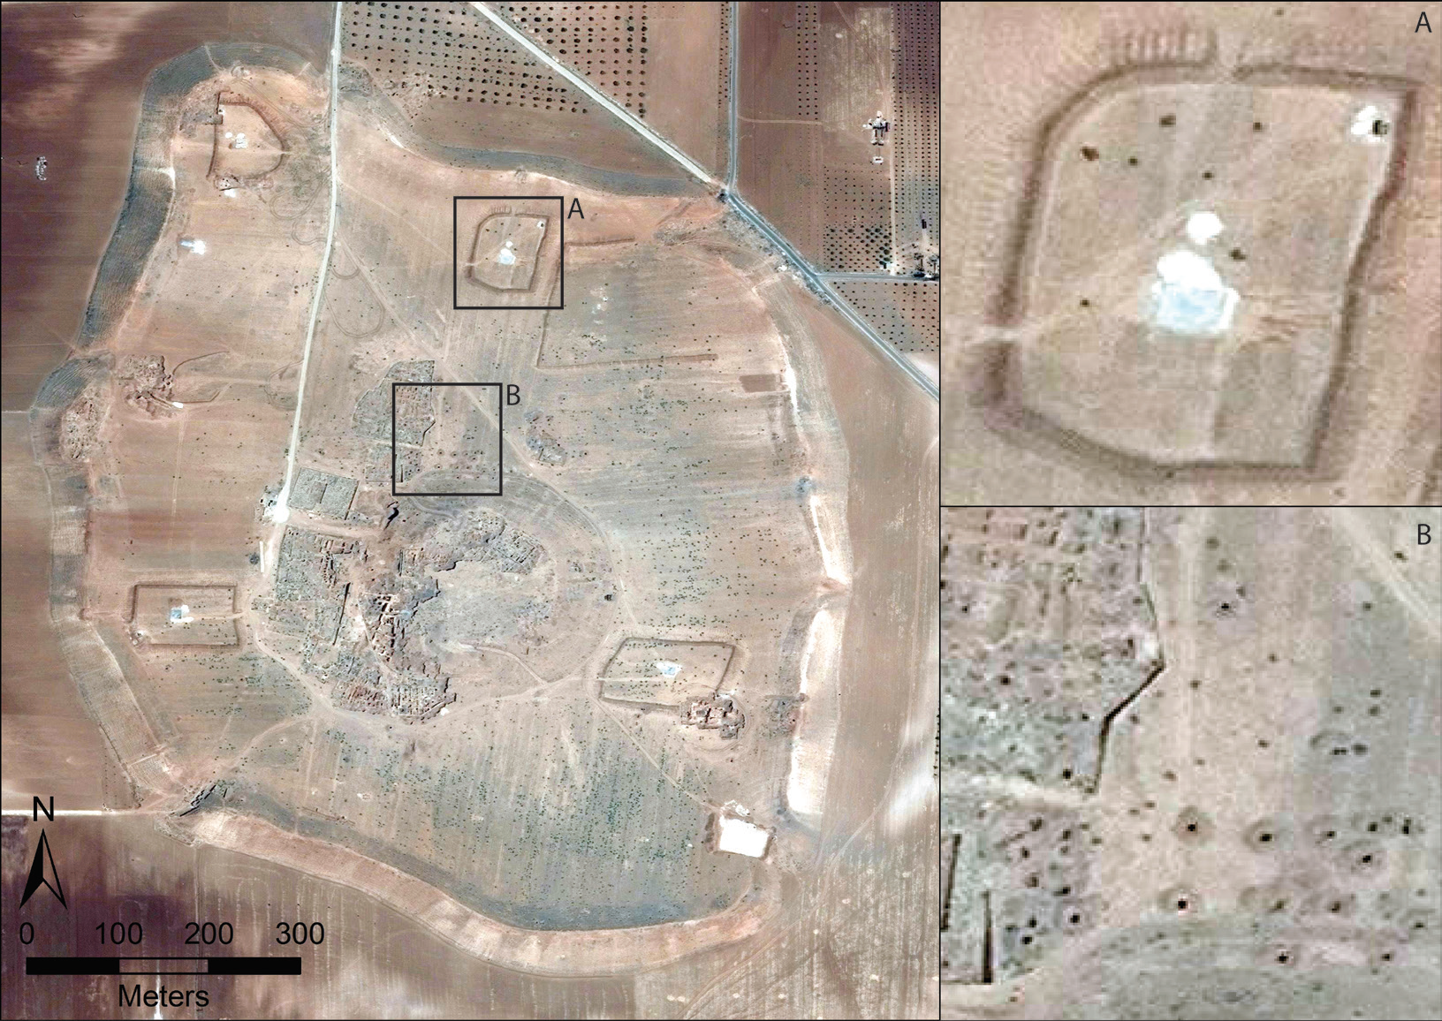
Introduction - Looting and the Funding of Terrorism
ISIS destroys archaeological sites under the premise of idolatry, while confiscating the most valuable artifacts for later sale on the black market.
Evidence of widespread site looting is detected using satellite imagery from the region.
Long-term repercussions of these actions multifaceted
Terrorism funding
Destruction of cultural identity
2014 Satellite imagery of the Bronze Age city of Elba (present day Tell Mardikh (Casana, 2015).
Notes:
Recently, however, the rise of criminal iconoclasm has returned to the world stage with ISIS taking the lead in destruction of idolatrous cultural sites that they say must be eradicated from a true Islamic state. While they preach their message, in reality, they are destroying these sites for propaganda opportunities used to recruit forces and obtain donations from sympathizers to their cause. Poverty plays a role here. The abject poverty in much of the Middle East forces economically deprived villagers not only into the well-paying arms of ISIS, but also into subsistence looting in efforts to support themselves and their families.
Most importantly, one of the primary drivers in this equation is the law of supply and demand. Private collectors, museums and auction houses from the U.S. to the UK and Japan have an insatiable appetite for cultural property. Regardless of the numerous laws in many countries making trade in illicit antiquities a punishable crime, it is often very easy for collectors and museums to work around a lack of provenience. The simple fact is, if there was no demand for these objects, the extremist groups and opportunistic looters would have nowhere to sell their ill-gotten goods and cultural property might be spared.
The long-term repercussions of this theft are multifaceted. The act of looting destroys all archaeological context the artifacts may have had – thereby eradicating much of the information that archaeologist use to understand the where, when, and why questions that arise when trying to reconstruct past lifeways. Further, the funds from the illicit antiquities trade stock the coffers of terrorist organizations, allowing them to continue their missions of chaos and destruction. Additionally, an often forgotten repercussion of these acts is the destruction of the shared cultural identity that these objects and locations represent. The loss of cultural identity destabilizes the very make-up of society, thereby furthering the goals of extremist groups and limiting the abilities of social reconstruction.

Slide 4
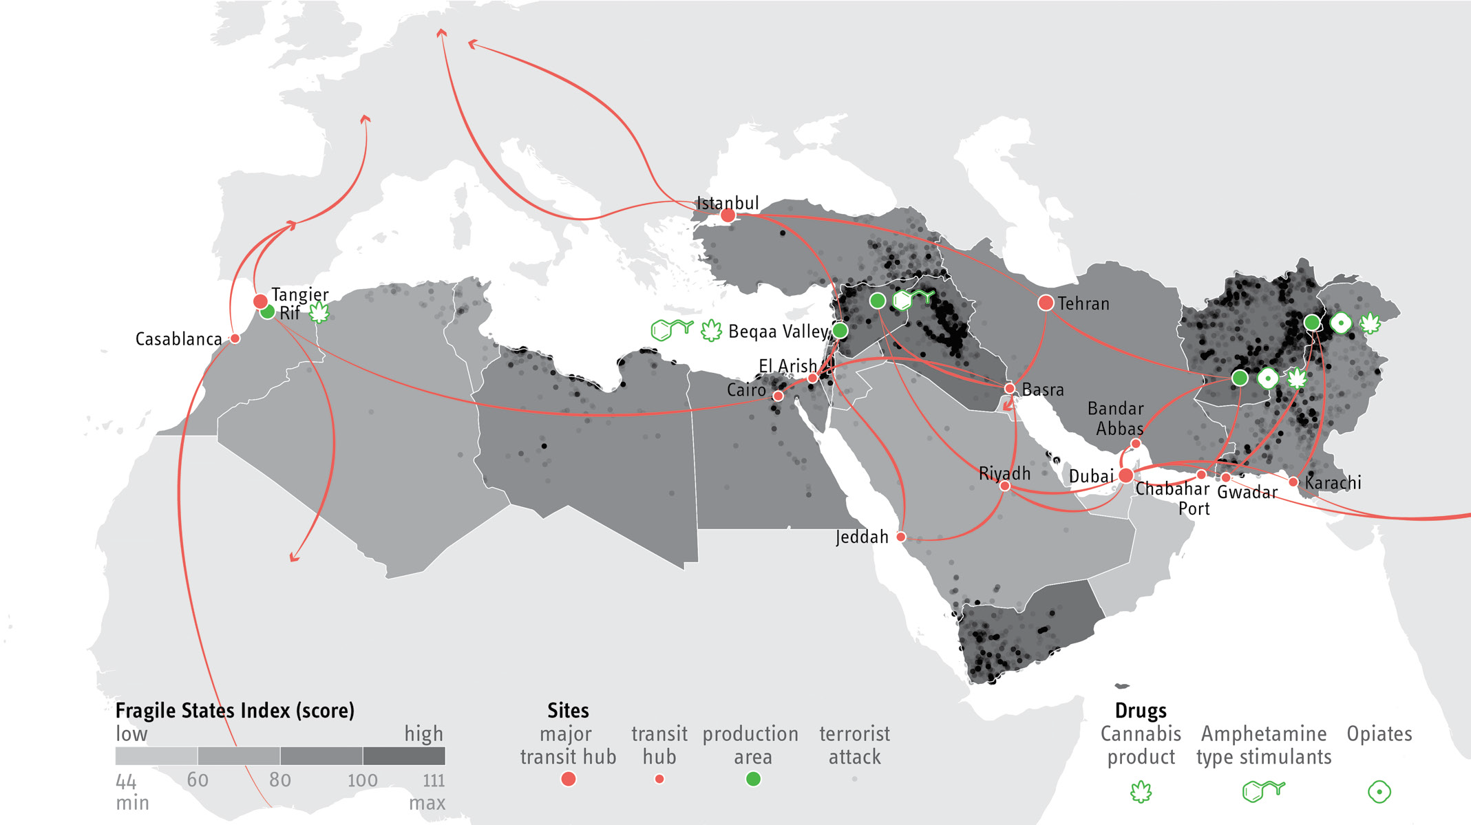
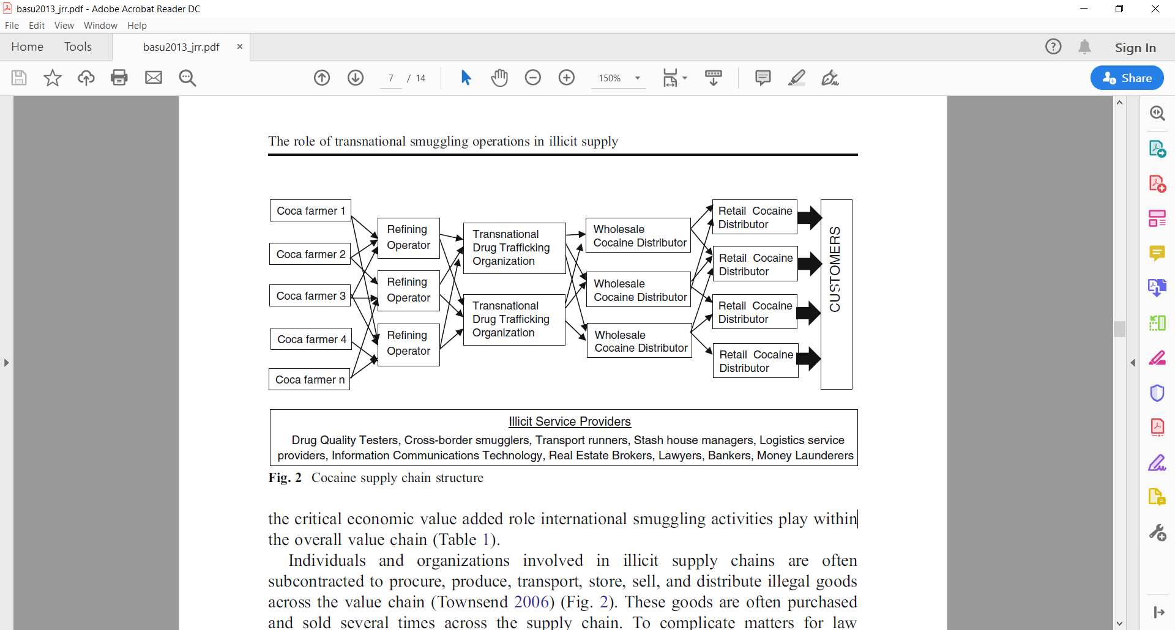
Introduction - Transnational Smuggling and Overland Trafficking
After illicit excavations, artifacts move from local looters to traffickers who transport the goods through road networks, across borders and, eventually, into the black market.
Research into localized and transnational smuggling provide insight into the trafficking of illicit antiquities.
Traffickers often plan out overland smuggling routes, taking several factors into consideration before deciding on the best route to travel.
Trafficking through the Middle East and North Africa (MENA region). (Barzoukas, 2017)
Cocaine supply chain structure (Basu, 2013)

Slide 5
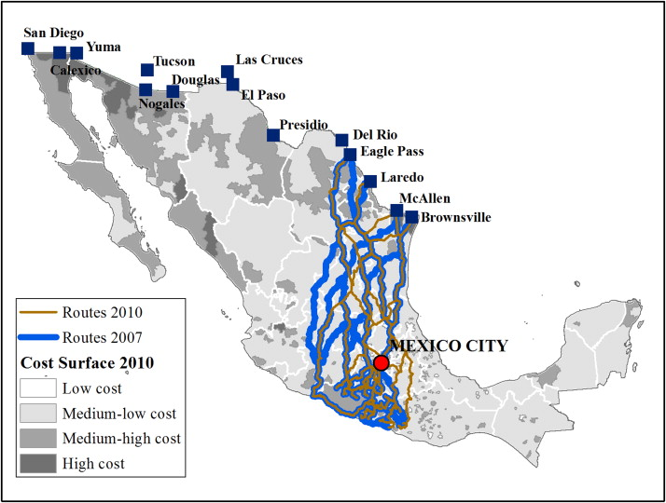
Topic / Purpose Statement
The intent of this line of work is to use computer simulations to help law enforcement and cultural heritage workers recover looted artifacts by identifying the most probable overland smuggling routes.
Predicted drug smuggling routes, MX (Medel, 2015).

Slide 6
Central Research Question
Is it possible to accurately predict the travel patterns of smugglers using computer routing models?
Subtopics:
What factors influence routing decisions and to what degree?
How do these decisions differ across regions?
Can these methods be applied to intercept looted artifacts in the MENA region?
Approach:
Qualitative:
Graph-theory to develop routes
Survey / questionnaires

Slide 7
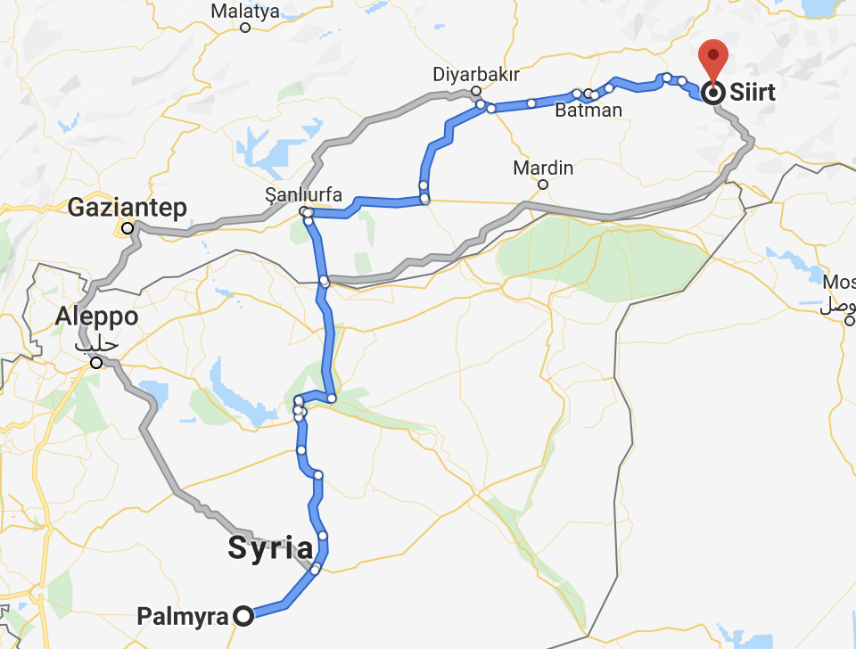
Hypothesis 1
Problem:
Considering the regional instability in the MENA region, standard shortest-path models may not be viable
Local smuggling routes are likely dependent on the other criminal activity in the region
Weak Points in border security
Enemy faction presence in an area
Route exposure to policing officials
Map showing looted site of Palmyra and city of Siirt, the location of recovered caches of illicit antiquities
Notes:
Since the beginning of the Syrian Civil war in 2011, extremist groups have taken advantage of the chaos and instability to loot and destroy archaeological sites and museums throughout Syria and into parts of Iraq, the most notable widely covered of which have been the 2014-2015 capture of Mosul and subsequent destruction of the Mosul Museum and Library.
• In 2015, ISIS took bulldozers and explosives to Nimrud, vandalizing Hatra, Nineveh, Khorsabad, and others. The destruction of Palmyra in 2016 was another devastating blow to world cultural heritage.
• While the primary players in this story that we are all familiar with are Al-Qaeda and ISIS, we must not forget the importance of local gangs of organized looters, as well as subsistence looters, that take advantage of inadequately protected cultural property to loot for a variety of reasons.
• So, why is this happening?
• The reasons why the destruction and looting of cultural property is happening both in the Middle East and across the globe seem to fall into a number of categories.
• Failure to protect archaeological sites and cultural property, poverty, religious ideology, propaganda, and last, but most certainly not least, supply and demand, are some of the contributing factors of this issue
• One of the biggest deterring forces to organized gangs of looters is site protection. Looters often avoid the hassle of sites that are actively policed by military or armed forces. During periods of political unrest, cultural heritage sites are often left unprotected as military and police resources are deployed to areas of greater need, making cultural property easy prey.
• Extremist Muslim groups have used religious ideology as a driving motivation for destruction of idolatrous heritage. The Taliban made no qualms about destroying the Bamiyan Buddhas in Afghanistan for just this very reason.
• Recently, however, the rise of criminal iconoclasm has returned to the world stage with ISIS taking the lead in destruction of idolatrous cultural sites that they say must be eradicated from a true Islamic state. While they preach their message, in reality, they are destroying these sites for propaganda opportunities used to recruit forces and obtain donations from sympathizers to their cause. Poverty plays a role here. The abject poverty in much of the Middle East forces economically deprived villagers not only into the well-paying arms of ISIS, but also into subsistence looting in efforts to support themselves and their families.
• Most importantly, one of the primary drivers in this equation is the law of supply and demand. Private collectors, museums and auction houses from the U.S. to the UK and Japan have an insatiable appetite for cultural property. Regardless of the numerous laws in many countries making trade in illicit antiquities a punishable crime, it is often very easy for collectors and museums to work around a lack of provenience. The simple fact is, if there was no demand for these objects, the extremist groups and opportunistic looters would have nowhere to sell their ill-gotten goods and cultural property might be spared.

Slide 8
Hypothesis 1
Problem:
Considering the regional instability in the MENA region, standard shortest-path models may not be viable
Local smuggling routes are likely dependent on the other criminal activity in the region
Weak Points in border security
Enemy faction presence in an area
Route exposure to policing officials
H1:
Incorporating these regional factors into a shortest-path routing graph model will lead to improved prediction of smuggling paths.

Slide 9
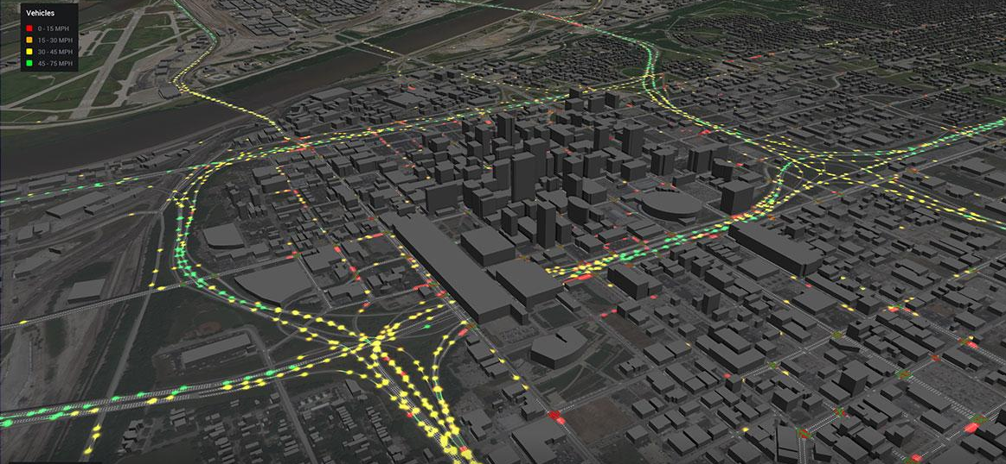
Hypothesis 2
Problem:
A major challenge for our model will be validation
While we’ve identified several contributing variables, the effect size of these variables is unclear
Approach:
Forced-choice survey where participants are asked to rank attributes that would be considered when deciding trafficking routes.
These results can serve as a ‘sanity check’ and also inform our model inputs moving forward

Slide 10
Hypothesis 2
Problem:
A major challenge for our model will be validation
While we’ve identified several contributing variables, the effect size of these variables is unclear
Approach:
Forced-choice survey where participants are asked to rank attributes that would be considered when deciding trafficking routes.
These results can serve as a ‘sanity check’ and also inform our model inputs moving forward
H2:
Enemy faction presence will be the strongest deterrent towards taking a path.

Slide 11

Hypothesis 3
Problem:
While we have information about trafficking in other places in the world, data on smuggling in the MENA region is limited
It is unclear if (and how) the instability in the Middle East would uniquely impact routing decisions
Our model primarily based on drug-smuggling in Central America
Is government corruption more widespread?
Is border crossing a larger concern?
Approach:
An exploratory survey distributed to participants with first-hand experience who live in the affected countries

Slide 12
Hypothesis 3
Problem:
While we have information about trafficking in other places in the world, data on smuggling in the MENA region is limited
It is unclear if (and how) the instability in the Middle East would uniquely impact routing decisions
Our model primarily based on drug-smuggling in Central America
Is government corruption more widespread?
Is border crossing a larger concern?
Approach:
An exploratory survey distributed to participants with first-hand experience who live in the affected countries
H3:
Geopolitical conflicts will have a larger impact on local routes taken in the MENA region.

Slide 13
Method: Tools
1. Graph Theory based Routing
Dijkstra’s shortest path
Nodes represent major waypoints
Edges represent pathways
Distances between nodes are weighted by our independent variables (IV)
2. Forced-choice survey
Participants choose between various model-generated routes
This will server as a first check for our model
The data we receive will be used to optimize our model inputs
3. Explorative Survey as primary source information
Questions will resemble structured interview
Distributed to people in the region
Provide insight for model application in MENA

Slide 14
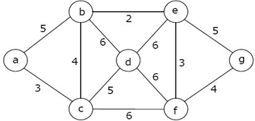
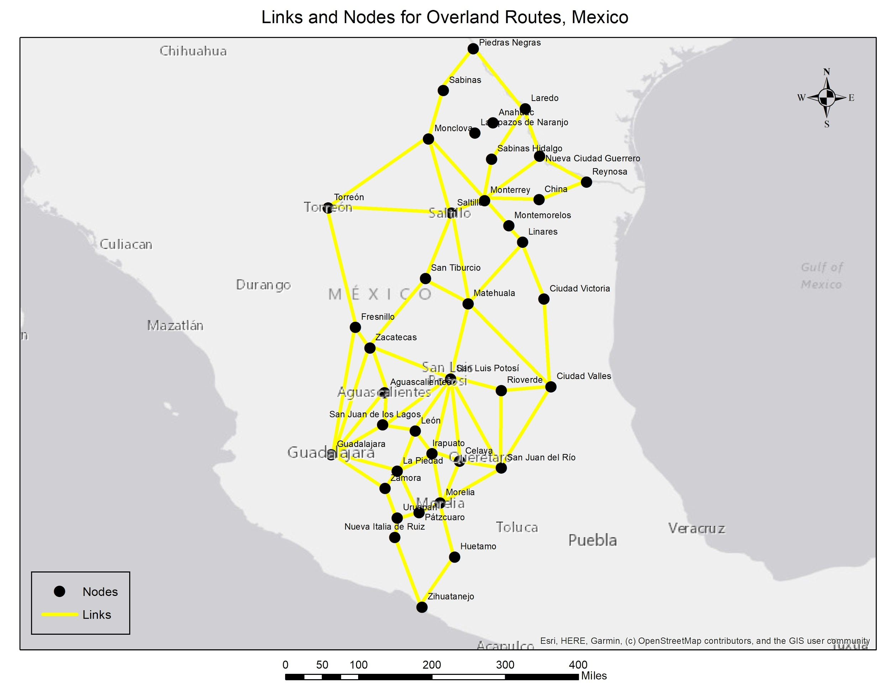
Method: Tools
1. Graph Theory
Dijkstra’s shortest path
Used to define the path through the graph that uses the weights of the edges
Simplistic algorithm to implement
Other algorithms have improved on Dijkstra, but are not used for this project. Some improves are on speed of processing
Routing using graph theory
Using graph theory to predict the most cost effective route between two points
Nodes represent cities that can be used in routes
Edges represent the connecting roadways between the cities
Distances between nodes are weighted by the independent variables
Distance between cities
Crime rate
Faction controlled
Circuity (road route vs. air route)
(“Graph Theory Types of Graphs—Javatpoint,” n.d.)
Notes:
In the top corner, you’ll see a generic model using graph theory. The circles are the nodes and the arrows are the edges. For our model, the nodes will represent major citites in Mexico and the edges will represent the connections between those cities.
Each edge in our model contains a score that aggregated the values for the distance, crime rate, cartel control, and population density.
Then, using Dijkstra’s shortest path algorithm, we are able to find the route through the model that navigates Mexico’s cities according to the least risk edges. In other words, the final route will contain the lowest combined value for distance, crime rate, and our other variables.

Slide 15
Method: Forced-choice Survey
Survey designed to help develop our model inputs
Building upon the work of Medel (2015), we identified a series of regional variables that could influence smuggling routes
Participants will be given contextual information about the task prior to completing survey
Asked to rate and provide feedback about important regional variables
Rate the importance and directionality of each
Rank the importance of all variables relative to each other
IRB Plan: We have completed and plan to file an exemption form to UCF’s IRB
Notes:
Before we could run our graph model, we had to find a way to combine all of our regional variables into a single aggregate score for the edges in the graph. To do this, we developed a force-choice survey that we can use to objectively assign weights to each of our independent variables. Then, we can normalize and combined these weights into a single score.
In our survey, which we called the Route Decision questionnaire, participants are asked to take the perspective of a smuggler and given some contextual information about the tasks. Then, they rate each of our 5 variables individually in part 1 and rank them relative to each other in part 2.

Slide 16
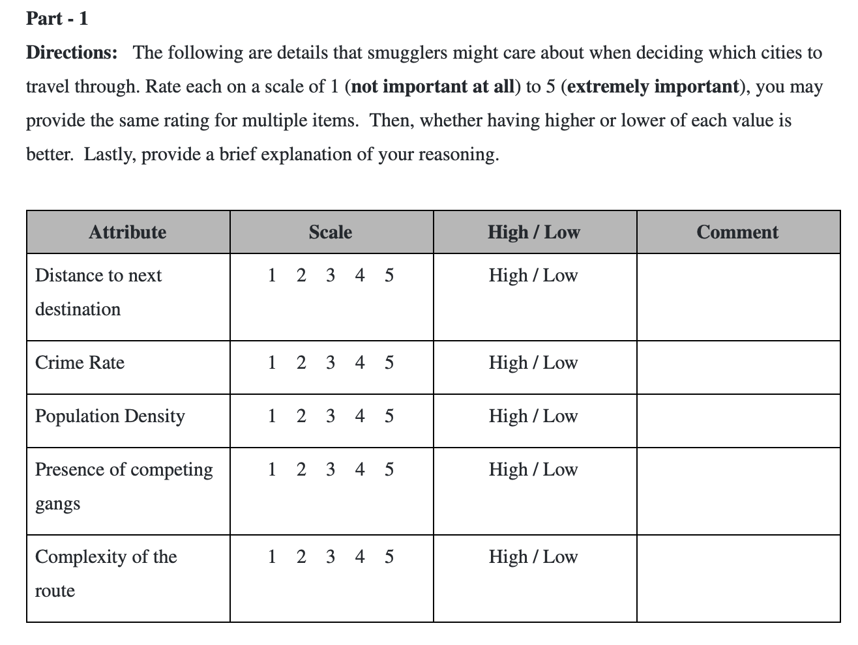
Method: Forced-choice Survey
Notes:
For part 1, participants rate the importance of distance, crime rate, population density, presence of competing gangs, and route complexity on a scale of 1-5. 1 being not at all important to smugglers and 5 being extremely important. These 5 variables were derived from previous liuterature on smuggling. We also left some some room so that we can collect data about directionality and for the participants to leave a brief explaination of their reasoning.

Slide 17
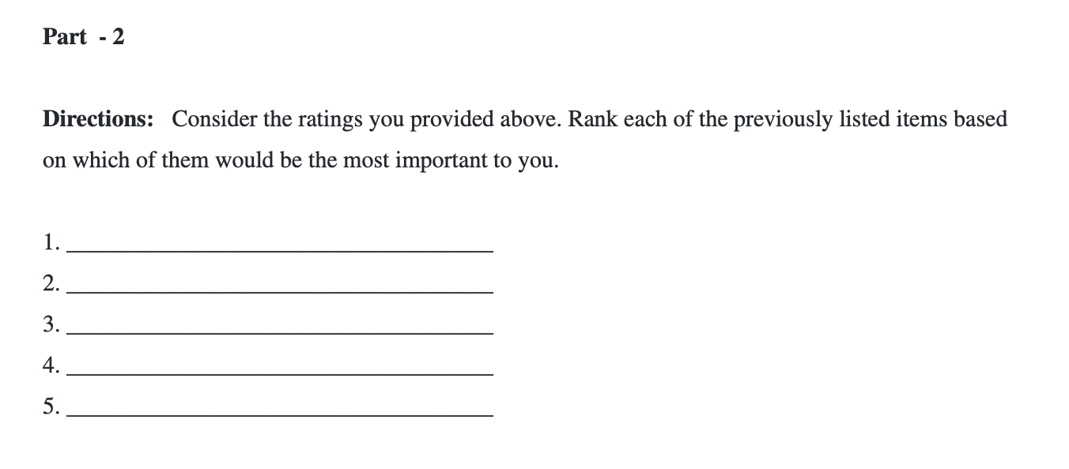
Method: Forced-choice Survey
Notes:
For part 2, they simply list the previous 5 variables from most to least importance. Having the relative rank and invidual rating for each of these variables allows us to more confidently combine their scores into one.

Slide 18
Method: Exploratory Survey
Topics will span:
Extortion and solicitation
Corruption
Illegal activity passing through customs
Demographics of respondents
Regional Conflicts
Purpose:
Collect local information to improve our understanding of how trafficking may be influenced by conditions in the MENA region
Participants:
Individuals who live in the Middle East and Africa
Notes:
The final survey that we developed, called the regional influence questionnaire, was primarily designed for future studies. In the regional influence questionnaire, we collect demographic information as well as data about local conflicts that could influence routing in the region. The intent is to distribute this survey in MENA so that we can better inform our model when we apply this methodology to artifact smuggling in the Middle East.

Slide 19
Method: Exploratory Survey, Pilot Study
Given the nature of this survey, the pilot study primarily served as a vetting opportunity to improve the questions and their structure.
The survey took participants no longer than 15 minutes to complete, with some completing the questions in under 5 minutes.
Feedback included:
Likert scale standardization
Additional questions to obtain more demographic information
Clarification specifically on question 10, regarding impact of personal belief on display of artifacts
Future work includes:
Incorporating feedback into survey structure
IRB Plan: We have completed and plan to file an exemption form to UCF’s IRB
Notes:
The current pilot study was an opportunity for us to vet both our Regional Influence Questionnaire and our Route Decision Questionnaire. Both studies were completed in under 15 minutes with some participants finishing in under 5 minutes. We received some feedback about our use of Likert scales and our collection of demographic information, but we have not had an opportunity to incorporate that feedback into our final graph model.
In the future, we plan to incorporate the feedback we received and file an exemption for to UCF’s IRB so that we can collect data.

Slide 20
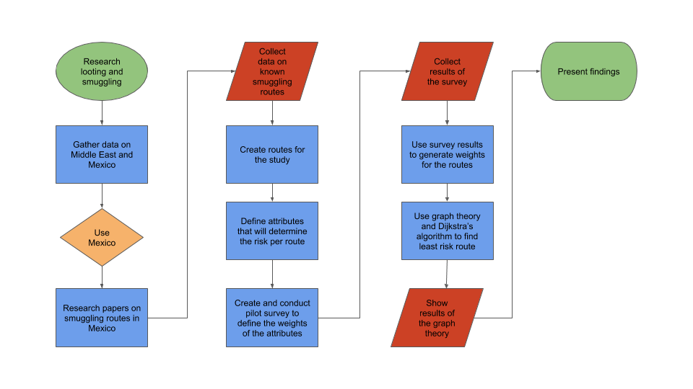
Workflow

Slide 21
City Information
City Information was gathered from several sources
City information was researched for crime rate, population, and cartel controlled
The data was tabulated for each of the cities defined in the routes
City | Crime Rate | Population | Cartel
Aguascalientes | 6.8 | 905,908 | Tierra Caliente
Celaya | 38.2 | 513,690 | Tierra Caliente
Ciudad Valles | 19.5 | 184,262 | Tamaulipas
Ciudad Victoria | 29.3 | 368,317 | Tamaulipas
Fresnillo | 42.3 | 231,904 | Tamaulipas
Sample table of city information

Slide 22
Route Information
Route information was determined from several resources
The linear distance was calculated from Google Earth
Path distance was determined from Google Maps
The circuitry was calculated for each route
The destination city’s population, crime rate, and cartel information was assigned to the routes
Route | Linear Distance (mi) | Path Distance (mi) | Circuity | Destination City Crime Rate | Destination Population
Zihuatanejo to Huetamo | 75.9 | 162.0 | 2.1 | 28.6 | 49,031
Zihuatanejo to Nueva Italia de Ruiz | 97.4 | 125.0 | 1.3 | 4.7 | 42,605
Nueva Italia de Ruiz to Uruapan | 25.3 | 36.2 | 1.4 | 74.6 | 348,643
Sample table of route information

Slide 23
Forced-Choice Survey: Results
The survey results were collected and processed to determine the weights of the route attributes
The attributes of ranking and score were used to calculate a composite values to be applied to the route’s attributes
The high/low was used to determine is a high or low value for a attribute equated to a risk level
Attribute | Score | Low/High | Ranking | Composite
Presence of Competing Gangs | 4.71 | Low | 1.86 | 3.93
Distance to Next Destination | 3.86 | Low | 2.43 | 3.21
Crime Rate | 3.14 | High | 3.14 | 2.50
Population Density | 2.86 | Low | 3.71 | 2.07
Complexity of the Route | 2.86 | Low | 3.86 | 2.00
Survey results and composite values

Slide 24
Route Weights
The route weights were calculated from the attributes of the routes and the survey results
The attributes for the routes were normalized between 0 and 1 using the min and max value for each attribute
The route’s attribute was multiplied by the survey composite values to form a weight for each route
The weight equates to the level of risk along each route segment
Route | Distance | Circuity | Crime | Population | Cartel | Route Weight
Zihuatanejo to Huetamo | 0.42 | 0.21 | 0.38 | 0.97 | 0.00 | 4.74
Zihuatanejo to Nueva Italia de Ruiz | 0.58 | 0.83 | 0.06 | 0.97 | 0.00 | 5.72
Nueva Italia de Ruiz to Uruapan | 0.98 | 0.72 | 1.00 | 0.78 | 0.00 | 8.73
Huetamo to Morelia | 0.57 | 0.51 | 0.55 | 0.50 | 0.00 | 5.28
Example of route weight data

Slide 25
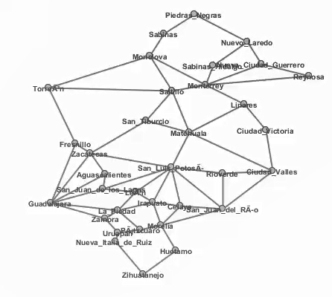
Graph Theory: Results
The routes with their respective weights were entered into Graph Tea
The cities were defined with the nodes
The routes were defined as edges with weights

Slide 26
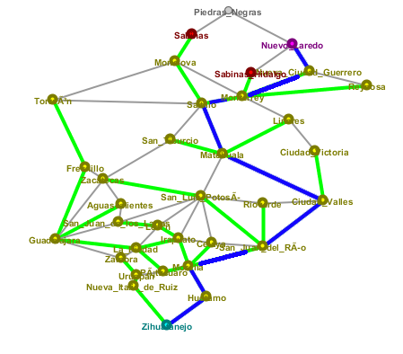
Graph Theory: Results
The path with the least amount of risk was determined
Within Graph Tea, the Dijkstra Algorithm was ran
The algorithm used the weights to determine the path with the least weights, in this case risk level
The path is shown below with the blue lines representing the route with the least amount of risk

Slide 27
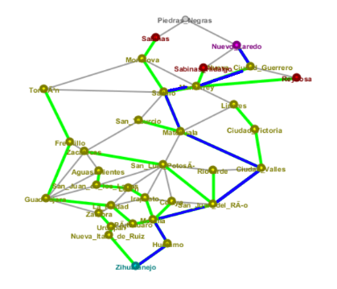
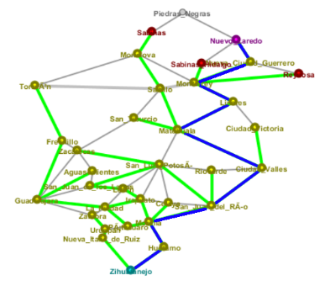
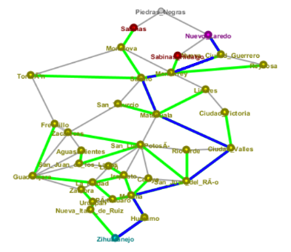
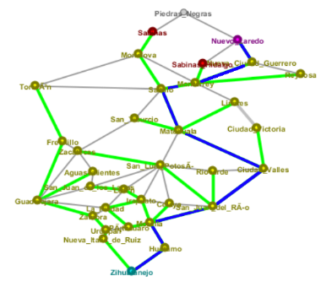
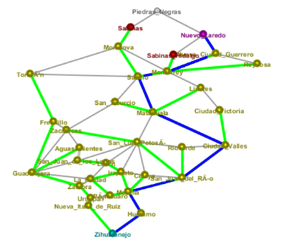
Graph Theory: Results
For completeness, a sensitivity analysis was conducted:
Within Graph Tea, the Dijkstra Algorithm was ran with four attributes only
The paths shown below confirm that the model is not highly sensitive to changes in input variables
Distance, Crime, Circuity, Population, Cartel Presence | Circuity, Crime, Population, Cartel Presence | Distance, Circuity, Crime, Cartel Presence | Distance, Circuity, Crime, Population | Distance, Circuity, Population, Cartel Presence | Distance, Crime, Population, Cartel Presence

Slide 28
Conclusion & Future Work
In conclusion, this project serves as a proof of concept for use of graph theory to predict routes
Within the time constraints of the project, several strengths and weaknesses have been identified about the model
Highly customizable and scalable
Requires more robust processes to calculate weights for model input
Additional analyses suggest that the generated model is not sensitive to changes in input variables, suggesting model stability
Future work includes
Apply model to MENA region
Conduct Regional Influence Survey
Adjust model attributes accordingly
Run model with locations from MENA
Greater sensitivity analyses
Incorporate additional KML data
Further project validation
Collecting data on locations where traffickers have been apprehended
Collecting first-hand experiences to test against model
Notes:
This project serves as a pilot study for using graph models to predict smugglings routes. Using graph theory presents a couple of pros and cons. The strength of our approach is that it is highly customizable and saleable. Using this same approach, we could build models to predict smugglings in the Middle east or Europe. Likewise, by using more nodes in the graph, we could increase the resolution of our model to make precise predictions.
The down side is that our approach requires a human-subjects data collection process in order to gather model inputs. This could be an obstacle depending on the region we are making predictions for.
In the future, we plan to apply our model to make predictions in MENA. Additionally, we will use historical data to try and validate the accuracy of our models predictions.

Slide 29
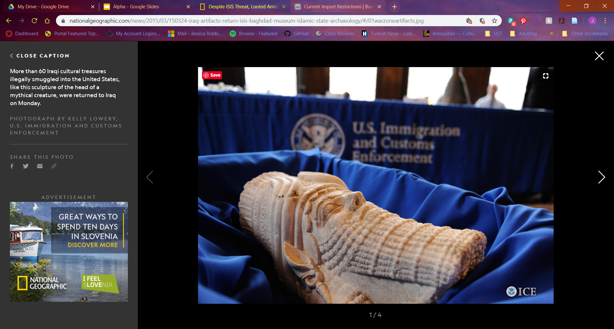


QUESTIONS?
Visit our GitHub repository for more information

Slide 30
REFERENCES
Alderman, K. L. (n.d.). Honor Amongst Thieves: Organized Crime and the Illicit Antiquities Trade. Indiana Law Review, 45, 27.
Barker, A. (2018a, June 5). Tracking the smugglers’ trail of priceless Islamic State loot to art markets in the West. Retrieved September 27, 2019, from ABC News (Australian Broadcasting Corporation website: https://www.abc.net.au/news/2018-06-06/priceless- antiques-looted-by-is-smuggled-into-western-markets/9833554
Barker, A. (2018b, June 6). A one-ton mosaic likely stolen from Syria turns up in the West. It’s the “tip of the iceberg” [Text]. Retrieved September 27, 2019, from ABC News website: https://www.abc.net.au/news/2018-06-06/priceless-antiques-looted-by-is-smuggled-into-western-markets/9833554
Barthélemy, J., & Carletti, T. (2017). An adaptive agent-based approach to traffic simulation. Transportation Research Procedia, 25, 1238–1248. https://doi.org/10.1016/j.trpro.2017.05.142
Barzoukas, G., & Institute for Security Studies (Paris, F. (2017). Drug trafficking in the MENA: The economics and the politics. Retrieved from http://dx.publications.europa.eu/10.2815/972478
Basu, G. (2013). The role of transnational smuggling operations in illicit supply chains. Journal of Transportation Security, 6(4), 315–328. https://doi.org/10.1007/s12198-013-0118-y
Basu, G. (2014). The strategic attributes of transnational smuggling: Logistics flexibility and operational stealth in the facilitation of illicit trade. Journal of Transportation Security, 7(2), 99–113. https://doi.org/10.1007/s12198-013-0132-0
Beittel, J. S. (n.d.). Mexico: Organized Crime and Drug Trafficking Organizations. 35.
Blannin, P. (2017). Islamic State’s Financing: Sources, Methods and Utilisation. 9(5), 11.
Blythe Bowman Proulx. (2013). Archaeological Site Looting in “Glocal” Perspective: Nature, Scope, and Frequency. American Journal of Archaeology, 117(1), 111. https://doi.org/10.3764/aja.117.1.0111
Brodie, N., & Mackenzie, S. (2014). Trafficking Cultural Objects: Introduction. European Journal on Criminal Policy and Research, 20(4), 421–426. https://doi.org/10.1007/s10610-014-9256-4
Brodie, N., & Renfrew, C. (2005). Looting and The World’s Archaeological Heritage: The Inadequate Response. Annual Review of Anthropology, 34(1), 343–361. https://doi.org/10.1146/annurev.anthro.34.081804.120551
Broek, A. C. van den, Schoemaker, R. M., & Dekker, R. J. (2014). Land Border Permeability and Irregular Migration Using Geospatial Intelligence from Satellite Data. 2014 IEEE Joint Intelligence and Security Informatics Conference, 208–211. https://doi.org/10.1109/JISIC.2014.38
Brunsdon, C., & Singleton, A. (2015). Geocomputation: A Practical Primer. https://doi.org/10.4135/9781473916432
Campbell, P. B. (2013). The Illicit Antiquities Trade as a Transnational Criminal Network: Characterizing and Anticipating Trafficking of Cultural Heritage. International Journal of Cultural Property, 20(2), 113–153. https://doi.org/10.1017/S0940739113000015
Casana, J. (2015). Satellite imagery-based analysis of archaeological looting in Syria. Near Eastern Archaeology, 78(3), 142–152.
Casana, & Panahipour. (2014). Satellite-Based Monitoring of Looting and Damage to Archaeological Sites in Syria. Journal of Eastern Mediterranean Archaeology & Heritage Studies, 2(2), 128. https://doi.org/10.5325/jeasmedarcherstu.2.2.0128
Danese, M., Masini, N., Biscione, M., & Lasaponara, R. (2014). Predictive modeling for preventive Archaeology: Overview and case study. Open Geosciences, 6(1). https://doi.org/10.2478/s13533-012-0160-5
Felner, A. (n.d.). Position Paper: Dijkstra’s Algorithm versus Uniform Cost Search or a Case Against Dijkstra’s Algorithm. 5.
Graph Theory Types of Graphs—Javatpoint. (n.d.). Retrieved December 8, 2019, from Www.javatpoint.com website: https://www.javatpoint.com/graph-theory-types-of-graphs
Grayson, G. W. (2014). The Evolution of Los Zetas in Mexico and Central America: Sadism as an Instrument of Cartel Warfare: https://doi.org/10.21236/ADA599872
Greenland, F. (2019). Introduction: New Insights into the Antiquities Market. International Journal of Cultural Property, 26(3), 211–225. https://doi.org/10.1017/S0940739119000237
Inside the hunt for Iraq’s looted treasures. (2019, July 10). Retrieved September 27, 2019, from The Independent website: https://www.independent.co.uk/news/world/middle-east/iraq-archaeology-museum-antiquities-looting-a8996676.html
Jenkins, J. L., Marquardson, J., Proudfoot, J. G., Valacich, J. S., Golob, E., & Nunamaker, J. F. (2013). The Checkpoint Simulation: A Tool for Informing Border Patrol Checkpoint Design and Resource Allocation. 2013 European Intelligence and Security Informatics Conference, 252–255. https://doi.org/10.1109/EISIC.2013.65
Jordan, C. (2016, December 17). New leads on looted Middle Eastern antiquities [Text]. Retrieved September 27, 2019, from TheHill website: https://thehill.com/blogs/congress-blog/foreign-policy/310831-new-leads-on-looted-middle-eastern-antiquities
Latek, M. M., Rizi, S. M. M., Crooks, A., & Fraser, M. (2012). Social Simulations for Border Security. 2012 European Intelligence and Security Informatics Conference, 340–345. https://doi.org/10.1109/EISIC.2012.50
Luke, C., & Kersel, M. (2005). A Retrospective and a Look Forward. Journal of Field Archaeology, 30(2), 191–200. https://doi.org/10.1179/009346905791072323
Madella, M., Rondelli, B., Lancelotti, C., Balbo, A., Zurro, D., Campillo, X. R., & Stride, S. (2014). Introduction to Simulating the Past. Journal of Archaeological Method and Theory, 21(2), 251–257. https://doi.org/10.1007/s10816-014-9209-8
Medel, M., Lu, Y., & Chow, E. (2015). Mexico’s drug networks: Modeling the smuggling routes towards the United States. Applied Geography, 60, 240–247. https://doi.org/10.1016/j.apgeog.2014.10.018
Parcak, S., Gathings, D., Childs, C., Mumford, G., & Cline, E. (2016). Satellite evidence of archaeological site looting in Egypt: 2002–2013. Antiquity, 90(349), 188–205. https://doi.org/10.15184/aqy.2016.1
Parks, S., Mcanany, P. A., & Murata, S. (2006). The Conservation of Maya Cultural Heritage: Searching for Solutions in a Troubled Region. Journal of Field Archaeology, 31(4), 425–432. https://doi.org/10.1179/009346906791071846
Rodríguez-Puente, R., & Lazo-Cortés, M. S. (2013). Algorithm for shortest path search in Geographic Information Systems by using reduced graphs. SpringerPlus, 2(1), 291. https://doi.org/10.1186/2193-1801-2-291
Rose-Greenland, F. (2014). Looters, collectors and a passion for antiquities at the margins of Italian society. Journal of Modern Italian Studies, 19(5), 570–582. https://doi.org/10.1080/1354571X.2014.962256
Samuel, S. (2018, March 19). It’s Disturbingly Easy to Buy Iraq’s Archeological Treasures. Retrieved September 27, 2019, from The Atlantic website: https://www.theatlantic.com/international/archive/2018/03/iraq-war-archeology-invasion/555200/
Sellers, W. I., Hill, R. A., & Logan, B. S. (2007). An agent-based model of group decision making in baboons. Philosophical Transactions of the Royal Society B: Biological Sciences, 362(1485), 1699–1710. https://doi.org/10.1098/rstb.2007.2064
Sørensen, M. L. S., & Viejo-Rose, D. (Eds.). (2015). War and Cultural Heritage: Biographies of Place. New York, NY: Cambridge University Press.
Stealing from history: The looting and destruction of Iraqi and Syrian heritage concern us all. (n.d.). Retrieved April 2, 2019, from The National website: https://www.thenational.ae/arts-culture/stealing-from-history-the-looting-and-destruction-of-iraqi-and-syrian-heritage-concern-us-all-1.308011
Sullivan, B. L. (n.d.). Stolen artifacts finding way into the world’s art markets. Retrieved September 27, 2019, from Baltimoresun.com website: https://www.baltimoresun.com/bal-te.fbi22apr22-story.html
Swann, S. (2019, May 2). “Loot-to-order” antiquities sold on Facebook. BBC News. Retrieved from https://www.bbc.com/news/world-middle-east-47628369
Visconti, A. (n.d.). Professor of Criminal Law, University of Naples II, Italy; Visiting Professor, Queen Mary University of London, UK; ISPAC Deputy Chair and Director. 210.
Wang, X. Z. (2018). The Comparison of Three Algorithms in Shortest Path Issue. Journal of Physics: Conference Series, 1087, 022011. https://doi.org/10.1088/1742-6596/1087/2/022011
Xue, G., Li, Z., Zhu, H., & Liu, Y. (2009). Traffic-Known Urban Vehicular Route Prediction Based on Partial Mobility Patterns. 2009 15th International Conference on Parallel and Distributed Systems, 369–375. https://doi.org/10.1109/ICPADS.2009.129

Slide 31
Backup

Slide 32
City Information
City | Crime Rate | Population | Cartel
Aguascalientes | 6.8 | 905908 | Tierra Caliente
Celaya | 38.2 | 513690 | Tierra Caliente
Ciudad Valles | 19.5 | 184262 | Tamaulipas
Ciudad Victoria | 29.3 | 368317 | Tamaulipas
Fresnillo | 42.3 | 231904 | Tamaulipas
Guadalajara | 22.5 | 1538374 | Shared
Huetamo | 28.6 | 49031 | Tierra Caliente
Irapuato | 53.7 | 584276 | Tierra Caliente
La Piedad | 22.3 | 107696 | Tierra Caliente

Slide 33
City Information
City | Crime Rate | Population | Cartel
León | 26.5 | 1575400 | Tierra Caliente
Linares | 0.0 | 89441 | Tamaulipas
Matehuala | 21.4 | 102579 | Tamaulipas
Monclova | 6.7 | 240033 | Tamaulipas
Monterrey | 17.1 | 1226064 | Shared
Morelia | 41.2 | 786782 | Tierra Caliente
Nueva Ciudad Guerrero | 0.0 | 5371 | Tamaulipas
Nueva Italia de Ruiz | 4.7 | 42605 | Tierra Caliente
Nuevo Laredo | 15.2 | 432926 | Tamaulipas

Slide 34
City Information
City | Crime Rate | Population | Cartel
Pátzcuaro | 14.7 | 95335 | Tierra Caliente
Piedras Negras | 7.1 | 168297 | Tamaulipas
Reynosa | 30.9 | 718857 | Tamaulipas
Rioverde | 10.0 | 100293 | Tamaulipas
Sabinas | 2.9 | 69718 | Tamaulipas
Sabinas Hidalgo | 10.3 | 38888 | Tamaulipas
Saltillo | 3.2 | 825244 | Tamaulipas
San Juan de los Lagos | 13.3 | 74932 | Tierra Caliente
San Juan del Río | 13.5 | 280960 | Tierra Caliente

Slide 35
City Information
City | Crime Rate | Population | Cartel
San Luis Potosí | 20.4 | 854014 | Tamaulipas
San Tiburcio | 0.0 | 548 | Tamaulipas
Torreón | 11.1 | 723100 | Sinaloa
Uruapan | 74.6 | 348643 | Tierra Caliente
Zacatecas | 36.3 | 148752 | Tamaulipas
Zamora | 62.9 | 200205 | Tierra Caliente
Zihuatanejo | 103.8 | 132894 | Tierra Caliente

Slide 36
Route Information
Route | Linear Distance (mi) | Path Distance (mi) | Circuity | Destination City Crime Rate | Destination Population
Zihuatanejo to Huetamo | 75.9 | 162.0 | 2.1 | 28.6 | 49031
Zihuatanejo to Nueva Italia de Ruiz | 97.4 | 125.0 | 1.3 | 4.7 | 42605
Nueva Italia de Ruiz to Uruapan | 25.3 | 36.2 | 1.4 | 74.6 | 348643
Huetamo to Morelia | 74.2 | 128.0 | 1.7 | 41.2 | 786782
Uruapan to Pátzcuaro | 26.9 | 35.5 | 1.3 | 14.7 | 95335
Pátzcuaro to Morelia | 27.6 | 33.7 | 1.2 | 41.2 | 786782
Morelia to San Juan del Río | 85.6 | 151.0 | 1.8 | 13.5 | 280960

Slide 37
Route Information
Route | Linear Distance (mi) | Path Distance (mi) | Circuity | Destination City Crime Rate | Destination Population
Morelia to Celaya | 57.3 | 90.4 | 1.6 | 38.2 | 513690
Morelia to Irapuato | 65.8 | 86.6 | 1.3 | 53.7 | 584276
Celaya to Irapuato | 34.1 | 42.2 | 1.2 | 53.7 | 584276
Irapuato to Celaya | 34.1 | 42.2 | 1.2 | 38.2 | 513690
San Juan del Río to Celaya | 49.9 | 65.6 | 1.3 | 38.2 | 513690
Celaya to San Juan del Río | 49.9 | 65.6 | 1.3 | 13.5 | 280960
Pátzcuaro to La Piedad | 58.4 | 132.0 | 2.3 | 22.3 | 107696

Slide 38
Route Information
Route | Linear Distance (mi) | Path Distance (mi) | Circuity | Destination City Crime Rate | Destination Population
Uruapan to Zamora | 40.9 | 64.9 | 1.6 | 62.9 | 200205
Zamora to La Piedad | 25.6 | 32.7 | 1.3 | 22.3 | 107696
La Piedad to Irapuato | 46.9 | 61.5 | 1.3 | 53.7 | 584276
Zamora to Guadalajara | 82.0 | 104.0 | 1.3 | 22.5 | 1538374
La Piedad to Guadalajara | 83.8 | 103.0 | 1.2 | 22.5 | 1538374
La Piedad to León | 56.4 | 69.6 | 1.2 | 26.5 | 1575400
Irapuato to León | 38.8 | 43.1 | 1.1 | 26.5 | 1575400

Slide 39
Route Information
Route | Linear Distance (mi) | Path Distance (mi) | Circuity | Destination City Crime Rate | Destination Population
San Juan del Río to San Luis Potosí | 134.0 | 159.0 | 1.2 | 20.4 | 854014
Celaya to San Luis Potosí | 105.0 | 160.0 | 1.5 | 20.4 | 854014
Irapuato to San Luis Potosí | 101.0 | 128.0 | 1.3 | 20.4 | 854014
León to San Luis Potosí | 82.4 | 112.0 | 1.4 | 20.4 | 854014
Guadalajara to San Juan de los Lagos | 70.3 | 89.2 | 1.3 | 13.3 | 74932
San Juan de los Lagos to San Luis Potosí | 102.0 | 119.0 | 1.2 | 20.4 | 854014

Slide 40
Route Information
Route | Linear Distance (mi) | Path Distance (mi) | Circuity | Destination City Crime Rate | Destination Population
León to San Juan de los Lagos | 38.5 | 50.6 | 1.3 | 13.3 | 74932
San Juan de los Lagos to León | 38.5 | 50.6 | 1.3 | 26.5 | 1575400
San Juan del Río to Rioverde | 105.0 | 255.0 | 2.4 | 10.0 | 100293
Rioverde to San Luis Potosí | 62.6 | 109.0 | 1.7 | 20.4 | 854014
San Luis Potosí to Rioverde | 62.6 | 109.0 | 1.7 | 10.0 | 100293
San Juan del Río to Ciudad Valles | 121.0 | 231.0 | 1.9 | 19.5 | 184262

Slide 41
Route Information
Route | Linear Distance (mi) | Path Distance (mi) | Circuity | Destination City Crime Rate | Destination Population
Rioverde to Ciudad Valles | 61.3 | 75.8 | 1.2 | 19.5 | 184262
Ciudad Valles to Rioverde | 61.3 | 75.8 | 1.2 | 10.0 | 100293
Ciudad Valles to Matehuala | 152.0 | 166.0 | 1.1 | 21.4 | 102579
San Luis Potosí to Matehuala | 101.0 | 121.0 | 1.2 | 21.4 | 102579
Ciudad Valles to Ciudad Victoria | 117.0 | 143.0 | 1.2 | 29.3 | 368317
Ciudad Victoria to Linares | 80.2 | 96.7 | 1.2 | 0.0 | 89441

Slide 42
Route Information
Route | Linear Distance (mi) | Path Distance (mi) | Circuity | Destination City Crime Rate | Destination Population
Matehuala to Linares | 104.0 | 142.0 | 1.4 | 0.0 | 89441
Linares to Monterrey | 72.7 | 80.9 | 1.1 | 17.1 | 1226064
Monterrey to Sabinas Hidalgo | 48.0 | 64.8 | 1.4 | 10.3 | 38888
Sabinas Hidalgo to Nuevo Laredo | 77.7 | 81.7 | 1.1 | 15.2 | 432926
Monterrey to Nueva Ciudad Guerrero | 86.0 | 108.0 | 1.3 | 0.0 | 5371
Nueva Ciudad Guerrero to Nuevo Laredo | 66.1 | 78.1 | 1.2 | 15.2 | 432926

Slide 43
Route Information
Route | Linear Distance (mi) | Path Distance (mi) | Circuity | Destination City Crime Rate | Destination Population
Monterrey to Reynosa | 125.0 | 136.0 | 1.1 | 30.9 | 718857
Reynosa to Nueva Ciudad Guerrero | 62.7 | 81.7 | 1.3 | 0.0 | 5371
Guadalajara to Aguascalientes | 103.0 | 138.0 | 1.3 | 6.8 | 905908
San Juan de los Lagos to Aguascalientes | 41.9 | 50.8 | 1.2 | 6.8 | 905908
Aguascalientes to Zacatecas | 57.2 | 73.2 | 1.3 | 36.3 | 148752
Guadalajara to Zacatecas | 149.0 | 199.0 | 1.3 | 36.3 | 148752

Slide 44
Route Information
Route | Linear Distance (mi) | Path Distance (mi) | Circuity | Destination City Crime Rate | Destination Population
San Luis Potosí to Zacatecas | 107.0 | 120.0 | 1.1 | 36.3 | 148752
Guadalajara to Fresnillo | 172.0 | 217.0 | 1.3 | 42.3 | 231904
Zacatecas to Fresnillo | 29.5 | 37.8 | 1.3 | 42.3 | 231904
Zacatecas to San Tiburcio | 113.0 | 127.0 | 1.1 | 0.0 | 548
Matehuala to San Tiburcio | 63.6 | 73.9 | 1.2 | 0.0 | 548
San Tiburcio to Saltillo | 92.3 | 108.0 | 1.2 | 3.2 | 825244

Slide 45
Route Information
Route | Linear Distance (mi) | Path Distance (mi) | Circuity | Destination City Crime Rate | Destination Population
Matehuala to Saltillo | 121.0 | 158.0 | 1.3 | 3.2 | 825244
Saltillo to Monterrey | 43.7 | 54.2 | 1.2 | 17.1 | 1226064
Fresnillo to Torreón | 166.0 | 205.0 | 1.2 | 11.1 | 723100
Saltillo to Torreón | 149.0 | 157.0 | 1.1 | 11.1 | 723100
Torreón to Saltillo | 149.0 | 157.0 | 1.1 | 3.2 | 825244
Torreón to Monclova | 153.0 | 229.0 | 1.5 | 6.7 | 240033
Saltillo to Monclova | 106.0 | 123.0 | 1.2 | 6.7 | 240033
Monterrey to Monclova | 105.0 | 121.0 | 1.2 | 6.7 | 240033

Slide 46
Route Information
Route | Linear Distance (mi) | Path Distance (mi) | Circuity | Destination City Crime Rate | Destination Population
Monclova to Sabinas | 67.0 | 71.4 | 1.1 | 2.9 | 69718
Sabinas to Piedras Negras | 63.8 | 75.6 | 1.2 | 7.1 | 168297
Piedras Negras to Nuevo Laredo | 103.0 | 110.0 | 1.1 | 15.2 | 432926

Slide 47
Survey Results
Distance to Next Destination
Score | Low/High | Ranking
4 | High | 1
3 | High | 4
3 | Low | 3
5 | Low | 3
5 | Low | 2
3 | Low | 3
4 | Low | 1
3.86 | Low | 2.43

Slide 48
Survey Results
Crime Rate
Score | Low/High | Ranking
3 | High | 3
2 | High | 2
4 | High | 2
5 | Low | 2
4 | Both | 4
2 | Low | 5
2 | Low | 4
3.14 | High | 3.14

Slide 49
Survey Results
Population Density
Score | Low/High | Ranking
3 | Low | 4
4 | High | 5
1 | High | 5
2 | High | 5
4 | Low | 3
4 | Low | 1
2 | Low | 3
2.86 | Low | 3.71

Slide 50
Survey Results
Presence of Competing Gangs
Score | Low/High | Ranking
4 | High | 5
5 | DNA | 1
5 | High | 1
5 | Low | 1
5 | Low | 1
5 | Low | 2
4 | Low | 2
4.71 | Low | 1.86

Slide 51
Survey Results
Complexity of the Route
Score | Low/High | Ranking
4 | High | 2
4 | High | 3
2 | High | 4
3 | Low | 4
2 | Low | 5
3 | Low | 4
2 | Low | 5
2.86 | Low | 3.86

Slide 52
Route Weights
Route | Distance | Circuity | Crime | Population | Cartel | Route Weight
Zihuatanejo to Huetamo | 0.42 | 0.21 | 0.38 | 0.97 | 0.00 | 4.74
Zihuatanejo to Nueva Italia de Ruiz | 0.58 | 0.83 | 0.06 | 0.97 | 0.00 | 5.72
Nueva Italia de Ruiz to Uruapan | 0.98 | 0.72 | 1.00 | 0.78 | 0.00 | 8.73
Huetamo to Morelia | 0.57 | 0.51 | 0.55 | 0.50 | 0.00 | 5.28
Uruapan to Pátzcuaro | 0.99 | 0.81 | 0.20 | 0.94 | 0.00 | 7.22
Pátzcuaro to Morelia | 1.00 | 0.88 | 0.55 | 0.50 | 0.00 | 7.37
Morelia to San Juan del Río | 0.47 | 0.48 | 0.18 | 0.82 | 0.00 | 4.62
Morelia to Celaya | 0.74 | 0.62 | 0.51 | 0.67 | 0.00 | 6.29
Morelia to Irapuato | 0.76 | 0.81 | 0.72 | 0.63 | 0.00 | 7.15
Celaya to Irapuato | 0.96 | 0.86 | 0.72 | 0.63 | 0.00 | 7.91

Slide 53
Route Weights
Route | Distance | Circuity | Crime | Population | Cartel | Route Weight
Irapuato to Celaya | 0.96 | 0.86 | 0.51 | 0.67 | 0.00 | 7.48
San Juan del Río to Celaya | 0.85 | 0.81 | 0.51 | 0.67 | 0.00 | 7.03
Celaya to San Juan del Río | 0.85 | 0.81 | 0.18 | 0.82 | 0.00 | 6.51
Pátzcuaro to La Piedad | 0.55 | 0.12 | 0.30 | 0.93 | 0.00 | 4.70
Uruapan to Zamora | 0.86 | 0.61 | 0.84 | 0.87 | 0.00 | 7.89
Zamora to La Piedad | 1.00 | 0.84 | 0.30 | 0.93 | 0.00 | 7.56
La Piedad to Irapuato | 0.87 | 0.81 | 0.72 | 0.63 | 0.00 | 7.52
Zamora to Guadalajara | 0.68 | 0.84 | 0.30 | 0.02 | 0.67 | 7.30
La Piedad to Guadalajara | 0.68 | 0.87 | 0.30 | 0.02 | 0.67 | 7.37
La Piedad to León | 0.83 | 0.87 | 0.36 | 0.00 | 0.00 | 5.30

Slide 54
Route Weights
Route | Distance | Circuity | Crime | Population | Cartel | Route Weight
Irapuato to León | 0.95 | 0.96 | 0.36 | 0.00 | 0.00 | 5.87
San Juan del Río to San Luis Potosí | 0.43 | 0.90 | 0.27 | 0.46 | 1.00 | 8.75
Celaya to San Luis Potosí | 0.43 | 0.66 | 0.27 | 0.46 | 1.00 | 8.25
Irapuato to San Luis Potosí | 0.57 | 0.84 | 0.27 | 0.46 | 1.00 | 9.08
León to San Luis Potosí | 0.64 | 0.78 | 0.27 | 0.46 | 1.00 | 9.18
Guadalajara to San Juan de los Lagos | 0.75 | 0.84 | 0.18 | 0.95 | 0.00 | 6.50
San Juan de los Lagos to San Luis Potosí | 0.61 | 0.92 | 0.27 | 0.46 | 1.00 | 9.36
León to San Juan de los Lagos | 0.92 | 0.81 | 0.18 | 0.95 | 0.00 | 6.99
San Juan de los Lagos to León | 0.92 | 0.81 | 0.36 | 0.00 | 0.00 | 5.46
San Juan del Río to Rioverde | 0.00 | 0.00 | 0.13 | 0.94 | 1.00 | 6.20

Slide 55
Route Weights
Route | Distance | Circuity | Crime | Population | Cartel | Route Weight
Rioverde to San Luis Potosí | 0.66 | 0.50 | 0.27 | 0.46 | 1.00 | 8.67
San Luis Potosí to Rioverde | 0.66 | 0.50 | 0.13 | 0.94 | 1.00 | 9.31
San Juan del Río to Ciudad Valles | 0.11 | 0.38 | 0.26 | 0.88 | 1.00 | 7.51
Rioverde to Ciudad Valles | 0.81 | 0.87 | 0.26 | 0.88 | 1.00 | 10.73
Ciudad Valles to Rioverde | 0.81 | 0.87 | 0.13 | 0.94 | 1.00 | 10.53
Ciudad Valles to Matehuala | 0.40 | 0.97 | 0.29 | 0.94 | 1.00 | 9.81
San Luis Potosí to Matehuala | 0.60 | 0.89 | 0.29 | 0.94 | 1.00 | 10.31
Ciudad Valles to Ciudad Victoria | 0.50 | 0.88 | 0.39 | 0.77 | 1.00 | 9.87
Ciudad Victoria to Linares | 0.71 | 0.89 | 0.00 | 0.94 | 1.00 | 9.95
Matehuala to Linares | 0.51 | 0.77 | 0.00 | 0.94 | 1.00 | 9.06

Slide 56
Route Weights
Route | Distance | Circuity | Crime | Population | Cartel | Route Weight
Linares to Monterrey | 0.78 | 0.96 | 0.23 | 0.22 | 0.67 | 8.09
Monterrey to Sabinas Hidalgo | 0.86 | 0.78 | 0.14 | 0.98 | 1.00 | 10.61
Sabinas Hidalgo to Nuevo Laredo | 0.78 | 1.00 | 0.20 | 0.73 | 1.00 | 10.45
Monterrey to Nueva Ciudad Guerrero | 0.66 | 0.85 | 0.00 | 1.00 | 1.00 | 9.82
Nueva Ciudad Guerrero to Nuevo Laredo | 0.80 | 0.91 | 0.20 | 0.73 | 1.00 | 10.31
Monterrey to Reynosa | 0.54 | 0.97 | 0.41 | 0.54 | 1.00 | 9.76
Reynosa to Nueva Ciudad Guerrero | 0.78 | 0.82 | 0.00 | 1.00 | 1.00 | 10.13
Guadalajara to Aguascalientes | 0.53 | 0.79 | 0.09 | 0.43 | 0.00 | 4.38
San Juan de los Lagos to Aguascalientes | 0.92 | 0.88 | 0.09 | 0.43 | 0.00 | 5.83
Aguascalientes to Zacatecas | 0.82 | 0.83 | 0.49 | 0.91 | 1.00 | 11.32

Slide 57
Route Weights
Route | Distance | Circuity | Crime | Population | Cartel | Route Weight
Guadalajara to Zacatecas | 0.25 | 0.79 | 0.49 | 0.91 | 1.00 | 9.42
San Luis Potosí to Zacatecas | 0.61 | 0.95 | 0.49 | 0.91 | 1.00 | 10.87
Guadalajara to Fresnillo | 0.17 | 0.85 | 0.57 | 0.85 | 1.00 | 9.36
Zacatecas to Fresnillo | 0.98 | 0.83 | 0.57 | 0.85 | 1.00 | 11.92
Zacatecas to San Tiburcio | 0.58 | 0.95 | 0.00 | 1.00 | 1.00 | 9.75
Matehuala to San Tiburcio | 0.81 | 0.92 | 0.00 | 1.00 | 1.00 | 10.46
San Tiburcio to Saltillo | 0.66 | 0.91 | 0.04 | 0.48 | 1.00 | 8.98
Matehuala to Saltillo | 0.44 | 0.82 | 0.04 | 0.48 | 1.00 | 8.06
Saltillo to Monterrey | 0.90 | 0.86 | 0.23 | 0.22 | 0.67 | 8.29
Fresnillo to Torreón | 0.22 | 0.87 | 0.15 | 0.54 | 1.00 | 7.88

Slide 58
Route Weights
Route | Distance | Circuity | Crime | Population | Cartel | Route Weight
Saltillo to Torreón | 0.44 | 1.00 | 0.15 | 0.54 | 1.00 | 8.84
Torreón to Saltillo | 0.44 | 1.00 | 0.04 | 0.48 | 1.00 | 8.44
Torreón to Monclova | 0.12 | 0.68 | 0.09 | 0.85 | 1.00 | 7.64
Saltillo to Monclova | 0.59 | 0.92 | 0.09 | 0.85 | 1.00 | 9.66
Monterrey to Monclova | 0.60 | 0.93 | 0.09 | 0.85 | 1.00 | 9.70
Monclova to Sabinas | 0.83 | 0.99 | 0.04 | 0.96 | 1.00 | 10.64
Sabinas to Piedras Negras | 0.81 | 0.90 | 0.10 | 0.89 | 1.00 | 10.42
Piedras Negras to Nuevo Laredo | 0.65 | 0.99 | 0.20 | 0.73 | 1.00 | 10.01
Saltillo to Torreón | 0.44 | 1.00 | 0.15 | 0.54 | 1.00 | 8.84
Torreón to Saltillo | 0.44 | 1.00 | 0.04 | 0.48 | 1.00 | 8.44

